Slide 1
Russian invasion of ukraine
By Daniel martin

Slide 2
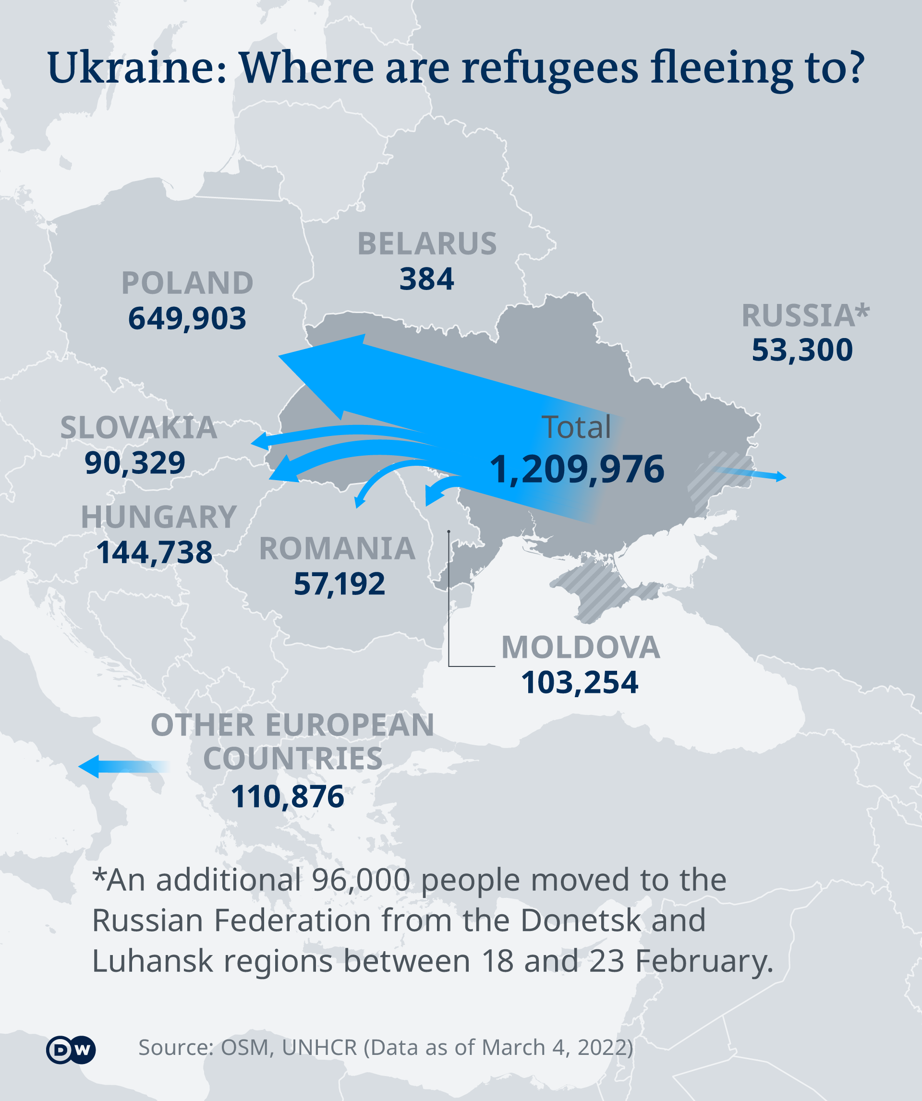
Ukraine migration
Due to the Russia-Ukraine crisis there has been more than a million innocent civilians have been forcedly removed from there home due to the Russian invasion.

Slide 3
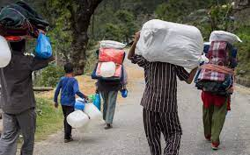
What is forced migration
A person that is forcibly moved from one place to another due to fighting in their home land. Without choice

Slide 4
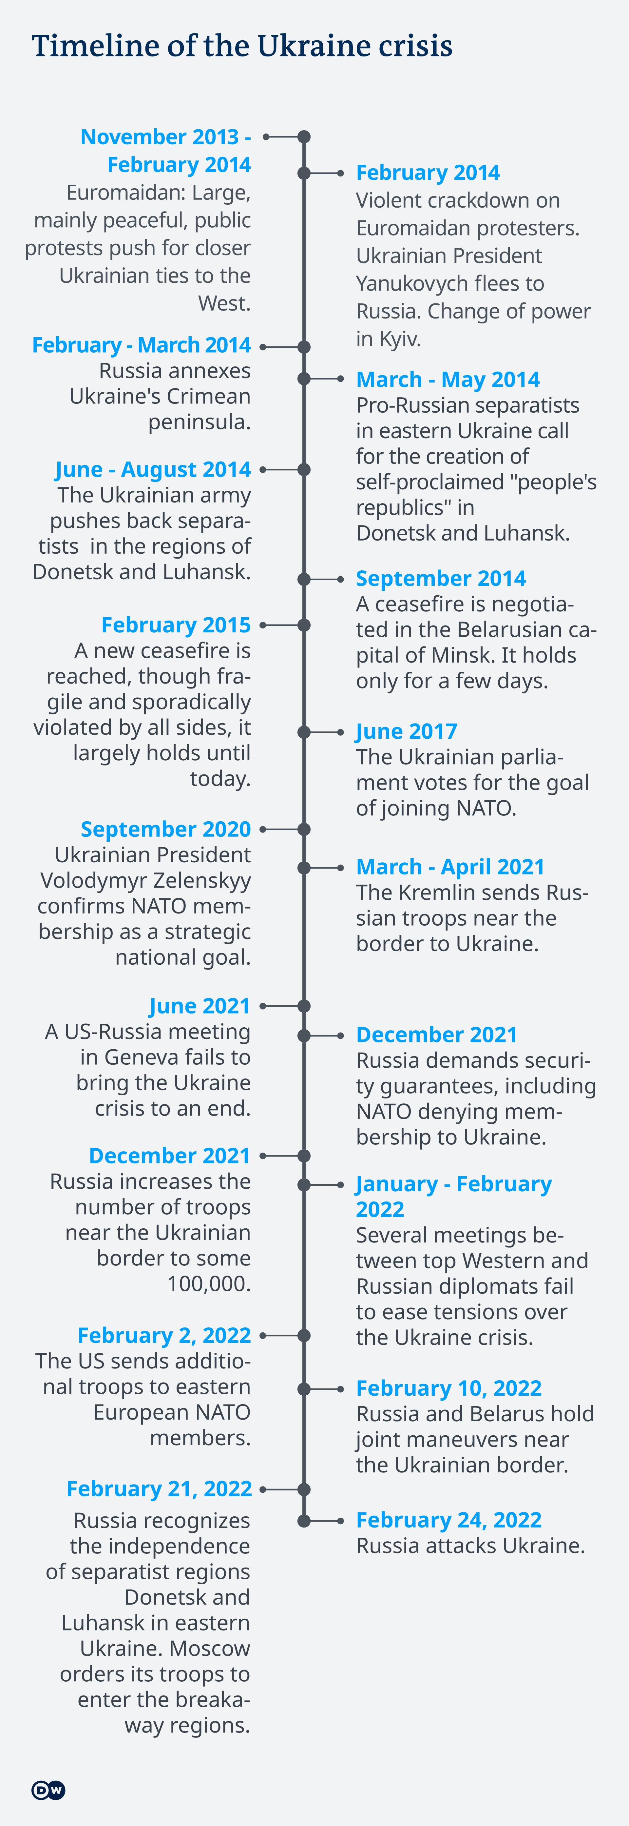
Timeline of events

Slide 5
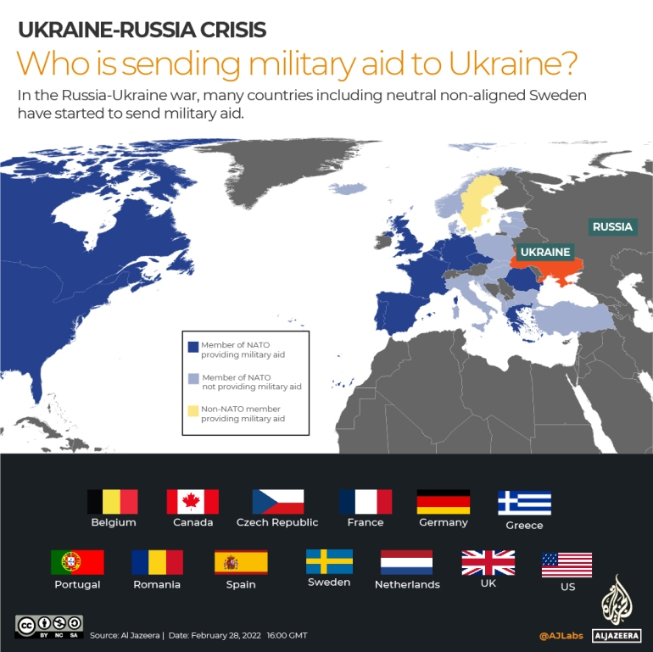
All major counties that sent support:
Belgium
France
Greece
Canada
Spain
Sweden
UK
US
Portugal
Romania
Germany
Czech republic
Netherlands
Ireland also supplied 10 million euro in humanitarian aid

